Slide 1
Cutting Tools

Slide 2
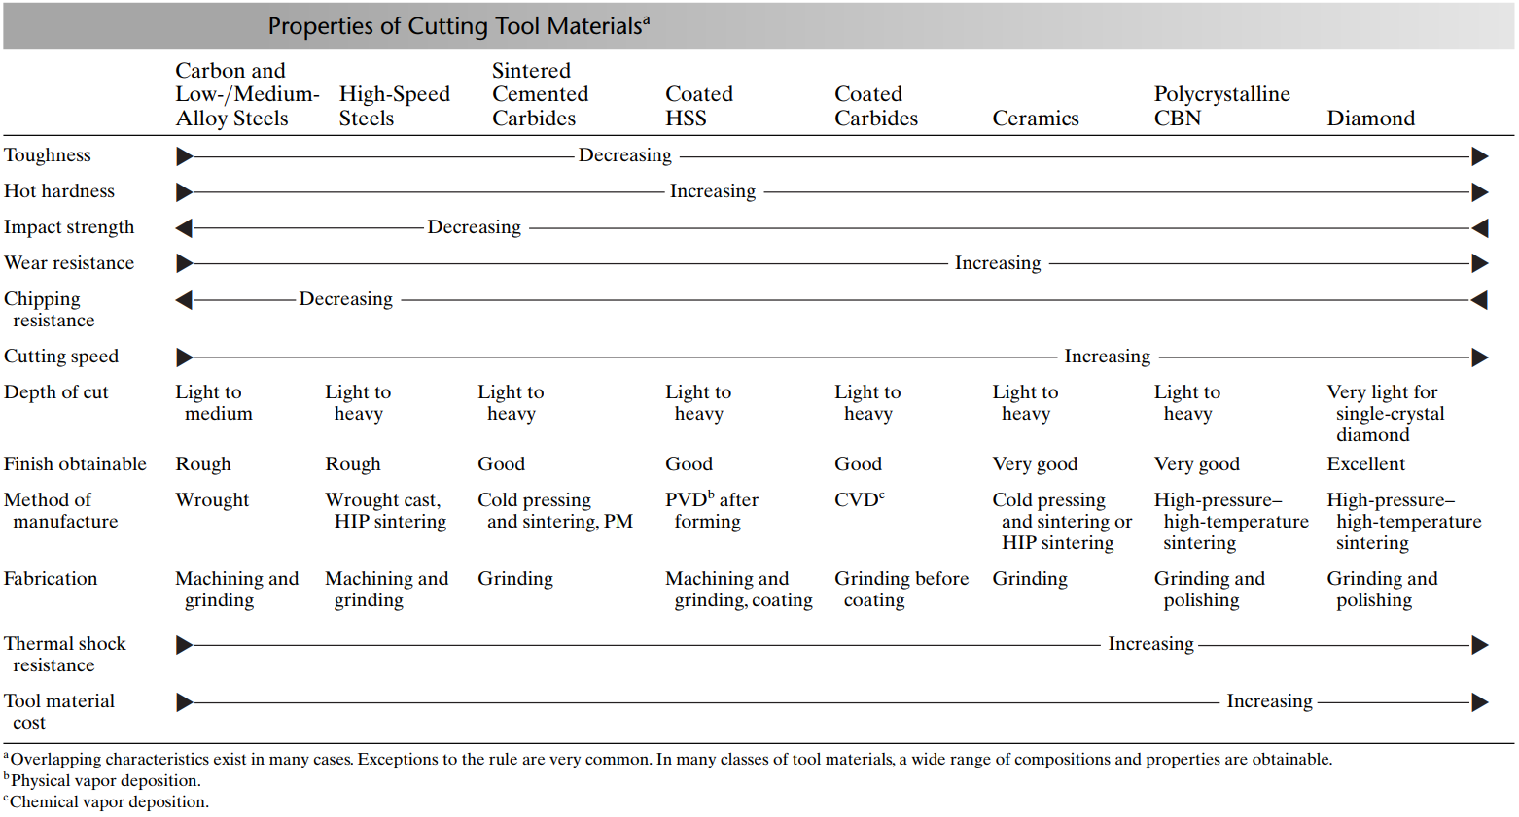
Salient Properties of Cutting Tool Materials

Slide 3

Watch Video Here
Notes:
Cutting Tool Materials

Slide 4
Desirable Tool Qualities
High hardness
High hardness temperature (hot hardness) – hardness decreases slowly with temperature
Resistance to abrasion and wear due to severe sliding friction
Resistance to chipping of the cutting edges
High toughness (impact strength) – for interrupted cuts
Strength to resist bulk deformation
Good chemical stability
Adequate thermal properties
High elastic modulus (stiffness)
Correct geometry and surface finish

Slide 5
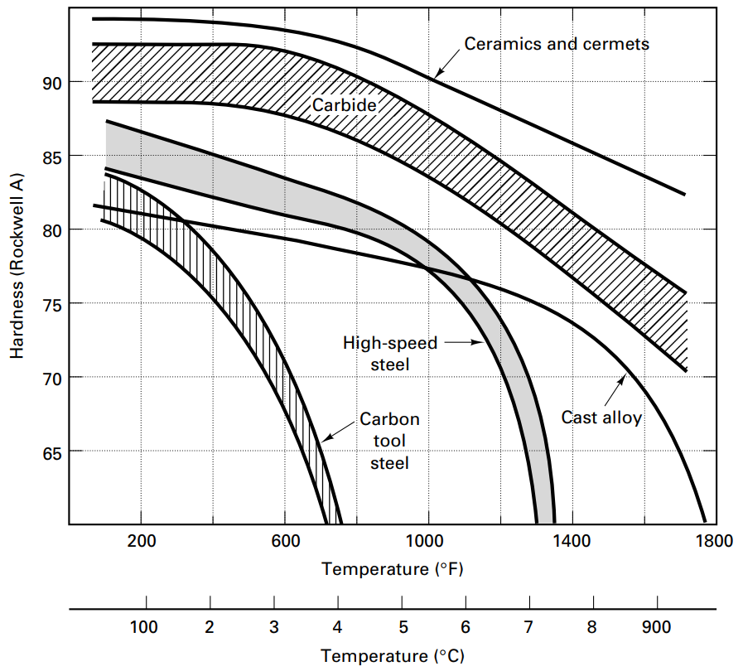
Hardness and Hot Hardness

Slide 6
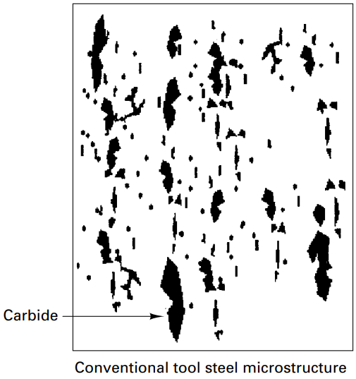
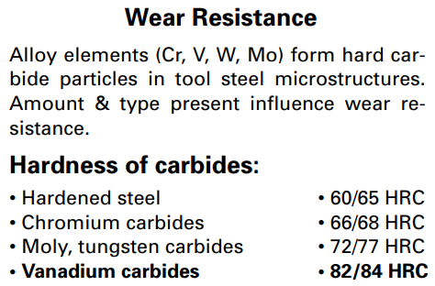
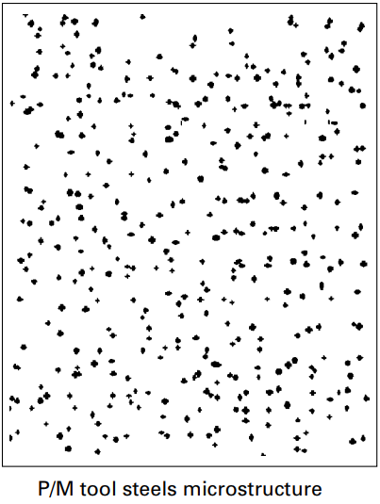

Carbide Distribution

Slide 7
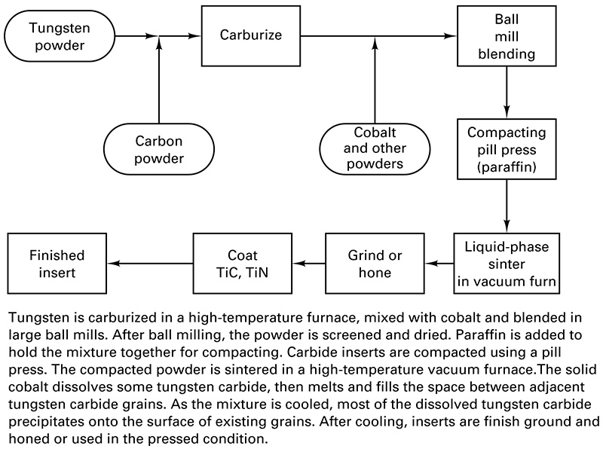
Powder Metallurgy Process

Slide 8
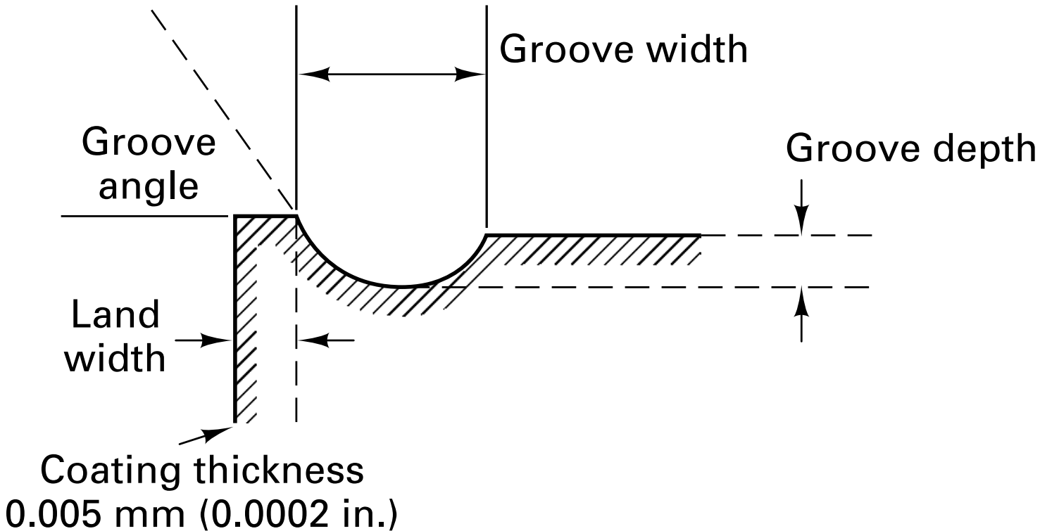
Carbide Insert Contours

Slide 9
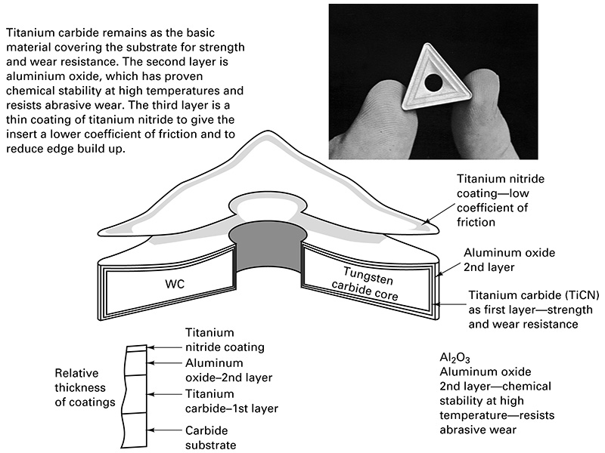
Coated Carbides

Slide 10
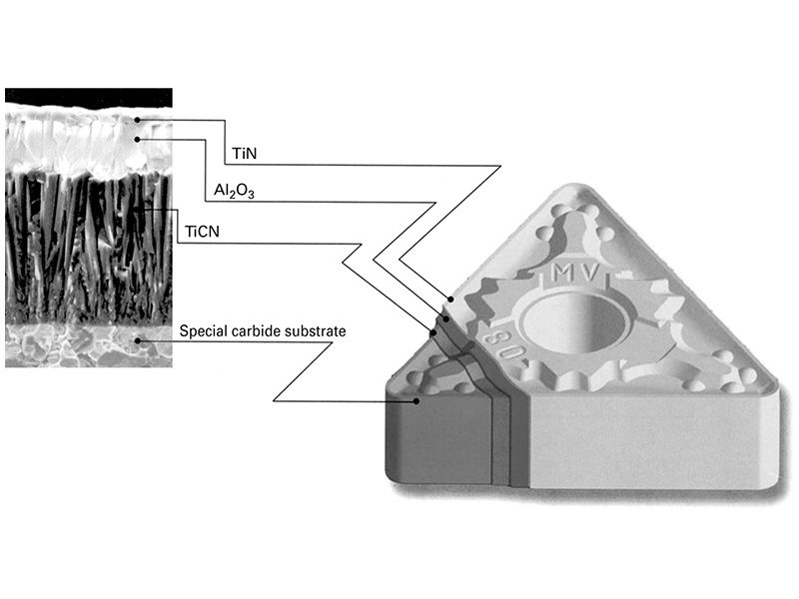
Coated Carbide with Chip Groove

Slide 11
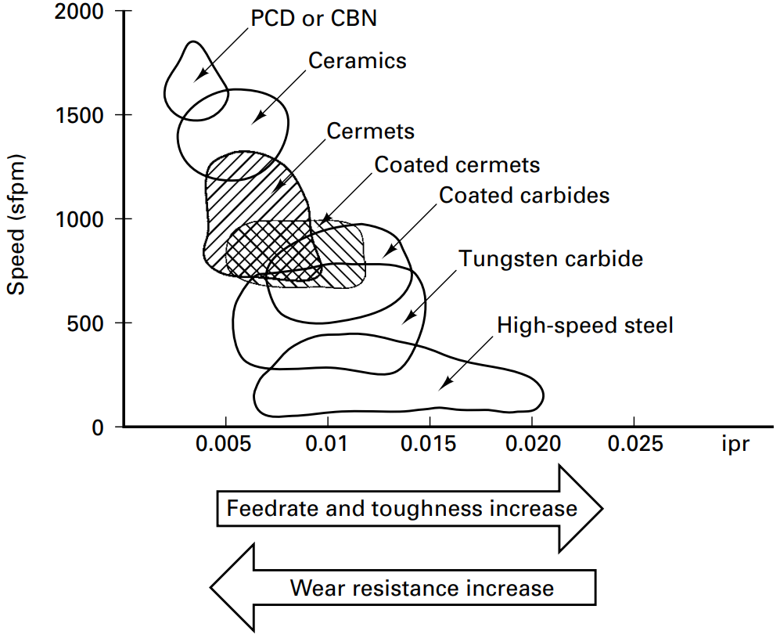
Cermets vs. other materials

